Slide 1
HOUSING: PRICE PREDICTION project
Presentation
Submitted by
HARIHARA SUDHAN

Slide 2
Acknowledgement:
I would like to express my deepest gratitude to my SME (Subject Matter Expert) Shubham Yadav as well as Flip Robo Technologies who gave me the opportunity to do this project on Housing: Price Prediction, which also helped me in doing lots of research wherein I came to know about so many new things.
Also, I have utilized a few external resources that helped me to complete the project. I ensured that I learn from the samples and modify things according to my project requirement.

Slide 3
Agenda
Analytical Problem Framing
  Exploratory Data Analysis (EDA)
  Visualizations
Data Pre-Processing on train and test datasets
Model/s Development and Evaluation
Performing hyper parameter tuning, saving the best model and predicting the label
Conclusion and future work discussion

Slide 4
DATA PRE PROCESSING
Importing the necessary packages and libraries.
Reading the CSV file and converted into data frame.
Checking the data dimensions for the original dataset.
Looking for null values and accordingly fill the missing data.
Checking the summary of the dataset.
Checking unique values.
Checking all the categorical columns in the dataset.
Visualizing each features using matplotlib and seaborn.
Performing encoding using the ordinal encoder on categorical features.
Checking for co-relation/multi-collinearity in a heatmap.
Checking for Outliers/Skewness using boxen plot and distribution plot.
Perform Scaling using Standard Scaler method.
Checking for the final dimension of dataset to confirm the input details.
Creating train test split and the best random state found in the range 1-1000.

Slide 5
Visualisation
Female are more in number when compare to male in online shopping.
Delhi place the most online shopping counts when comparte to other cities.
Age between 20 to 40 are much in shopping online.
Using smart phone internet is high when compare to wifi and laptop..
Payment option and Return replacement method attracts the people more to online shopping.
Information on similar products and quality information makes the customers to strongly agree for online shopping.
Quickness to complete purchase and speed of delivery also plays major role for customers to strongly agree.

Slide 6
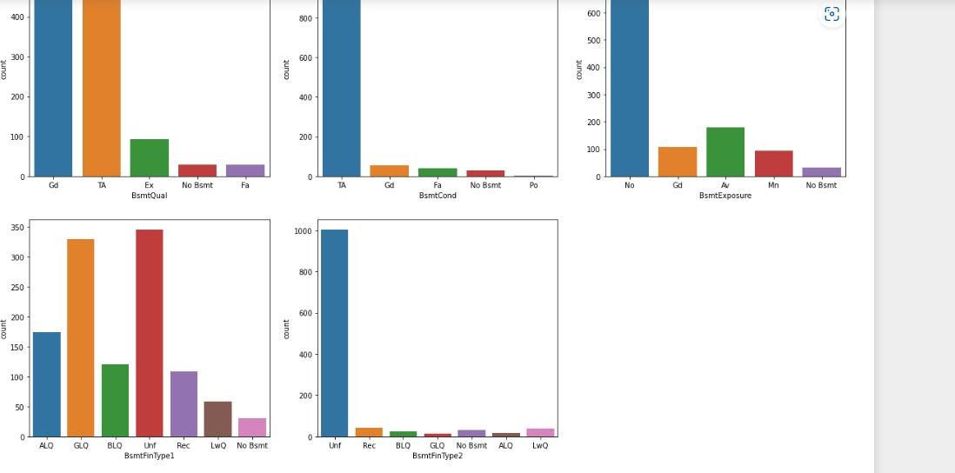
Countplot:

Slide 7
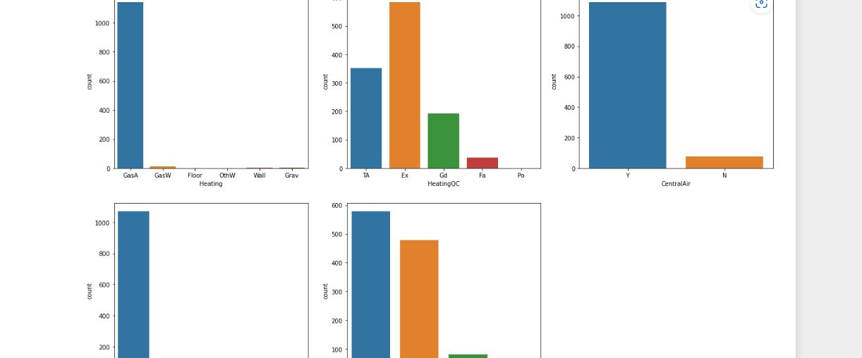
Parameters : This method is accepting the following parameters that are described below: x, y

Slide 8
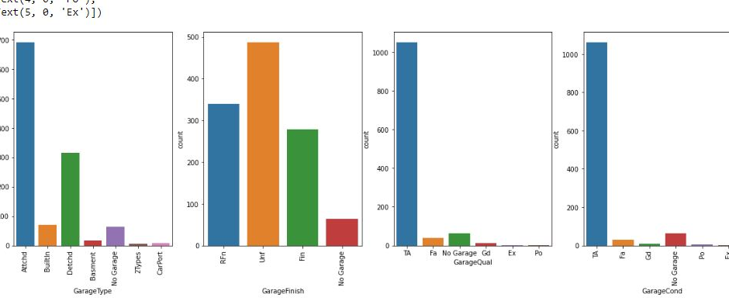
Count plot method is used to show the counts of observations in each categorical bin using bars..

Slide 9
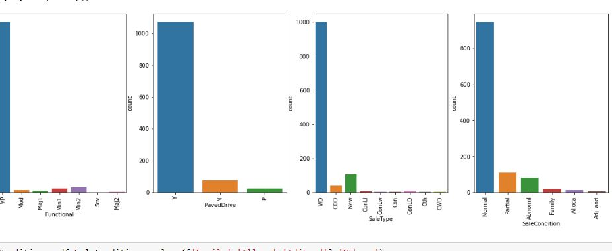
This parameter take names of variables in data or vector data, optional inputs for plotting long-form data

Slide 10
MODEL/S DEVELOPMENT
  Ridge Regularization Regression Model
  Lasso Regularization Regression Model
  Decision Tree Regression Model
  Random Forest Regression Model
  Gradient Boosting Regression Model
6. Bagging Classifier

Slide 11
EVALUATION AND HYPER PARAMETER TUNING
The key metrics used here were:
R2 score
Cross Validation Score
MAE
MSE
RMSE
We tried to find out the best parameters list to increase our accuracy scores by using Hyperparameter Tuning.
In order to achieve a higher score we used the Grid Search CV method with 5 folds.

Slide 12
CONCLUSION AND SCOPE FOR FUTURE WORK
During this project I have faced a problem of low amount of data for training the machine learning models upon.
Many columns are with same entries in more than 80% of rows which lead to reduction in our model performance.
One more issue present is there are large number of missing values in this data set, so we have to fill those missing values in correct manner manually.
We can still improve our model accuracy with some feature engineering and by doing some extensive hyperparameter tuning on it.

Slide 13
THANK YOU

